Slide 1
Data Usage Billing
Industry Overview
Cory McAboy

Slide 2
Threat of New Entry
Capital requirements
Existing players may “enter” other regions
Complex Regulation
Most new entrants are small
High level view of Data Usage Billing landscape
Internal Competition
Buyer Power
Price Sensitive Consumers
“Bill Shock”
Low switching costs
“Mono-home” industry
Supplier Power
Backbone providers
Telcos
Equipment
Existing Networks
Data Cap / No Data Cap
Data Usage policies
Price by Data Usage vs Flat Rate
Marketing Strategies
Quality of Service
Threat of Substitution
Project Loon
Facebook Connectivity Aircraft
Notes:
Monohome – Users typically only choose one service in a networked market.

Slide 3
Data Usage Billing is a growing trend among ISPs
Flat fee for internet access
Several Companies are introducing Data Caps
Data caps typically only affect less than 5% of the consumer base
Consumer ‘Bill Shock’ leads to dissatisfaction and churn.
Although small, Google Fiber is expanding and is aggressively marketing “No Data Caps”
*Charter and TWC will not induce a data cap for 7 years due to agreement with FCC

Slide 4
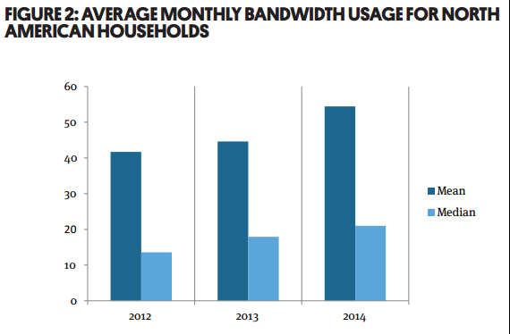
Data Usage is trending upward as streaming video adoption increases
Average Consumer Data Usage is increasing YoY
A small percentage of users skew the average data consumption up dramatically
70% of bandwidth in 2015 came from streaming video
4K video streaming adoption will increase usage even more.
Source: Sandvine Global Internet Phenomena Reports

Slide 5

The FCC has a very negative view on Data Caps and Data Usage Billing
FCC requires transparency
  ISPs must inform customers of Data Caps
TWC and Charter merger
  FCC requires 7 years of no data caps
Net Neutrality Regulation
  No Blocking
  No Throttling (slowing)
  No Paid Prioritization
FCC Chairman Tom Wheeler

Slide 6
Cable Providers have increased Broadband customers, but lost ground on TV customers despite an increase in total market size
Total Market Size
Broadband Customers
TV Customers

Slide 7
The Decline in TV Market Share can be contributed to the Rise of Online Streaming
Cable
As broadband adoption has increased, Cable Provider has increased market share whereas Telco has faltered.
More users are switching to streaming services, such as Netflix.
Telco Total
No Broadband Service
Telco DSL
Telco Fiber

